Slide 1
MODULE 4
Multiprocessor Operating Systems: Basic Multiprocessor
System Architectures – Interconnection Networks –Structures

Slide 2
INTRODCUTION
Multiprocessor system consist of several processors sharing a common physical memory.
All processors operate under the control of a single operating system.
Multiplicity of the processors and how they act together to perform a computation are transparent to the users.
The main motivation for multiprocessor systems are enhanced performance and fault tolerance.

Slide 3
Multiprocessor System Architectures
A multiprocessor system consist of multiple processors which execute different programs concurrently.
The main memory is shared among all processors.
Based on whether memory location can be directly accessed by a processor or not, there are two types of multi processor systems:
Tightly coupled and loosely coupled
Based on the vicinity and accessibility of memory to processor, there are 3 types of system architectures
UMA(Uniform memory-access) ,NUMA(non-uniform memory access) and
NORMA(No Remote Memory Access)

Slide 4
Tightly Coupled vs. Loosely Coupled Systems
Tightly Coupled
All processors share same memory address space and all processors can directly access a global main memory.
Main memory is used for interprocess communication & synchronization.
Processors are connected to a shared memory through an interconnection network.
Shared memory is divided into different modules and multiple modules can be accessed concurrently by different processors.
Memory contention occurs when 2 or more processors tries to access same memory module simultaneously.

Slide 5
Tightly Coupled vs. Loosely Coupled Systems
Loosely Coupled
Main memory is partitioned and attached to processors, but each processor has its own address space.
Processor cannot directly access memory attached to other processors.
Message passing is used for interprocess communication & synchronization.

Slide 6
UMA vs.NUMA vs.NORMA Architecture
In UMA main memory is located at a central location, such that it is equi distant from all processor w.r.t access time.
In addition to the central memory, processors may also have private memories, where they can cache data for higher performance.
In NUMA, main memory is physically partitioned and are attached to the processors.

Slide 7
UMA vs.NUMA vs.NORMA Architecture
All processors however share the same memory address space.
A processor can access memory attached to other processors, but the time taken for the same is high when compared to accessing its own partition.
In NORMA also main memory is physically partitioned and are attached to the processors.
But processor cannot directly access the memory of any other processor.
The processor must send messages over interconnection network to exchange information

Slide 8
Interconnection N/W for multiprocessor system
It provides data transfer facility b/w processors and memory modules for memory access.
Generally circuit switching is used to establish connection b/w processors and memory modules.
A dedicated path exists b/w the processors and the memory module.
Different types of inter connection networks include:
BUS
Cross-bar switch
Multistage interconnection network

Slide 9
BUS
Processors are connected to memory modules via a bus.
Simple, easy to implement and relatively inexpensive.
Bus can be a source of contention as bus can support only one processor-memory communication at any time.
This architecture can support only a limited no: of processors due to limited bandwidth of the bus.
Above problem can be resolved by multiple buses to connect processors and memories.

Slide 10
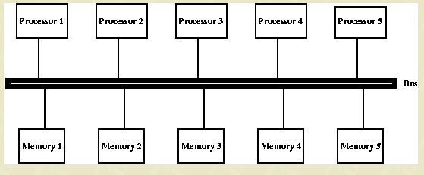
BUS

Slide 11
Cross–bar Switch
Cross-bar switch is a matrix that has a switch at every cross point.
gA Cross-bar is capable of providing an exclusive connection between any processor memory pair.
So all processors can access memory modules concurrently ,provided that each processor is accessing a different memory module.
A cross –bar switch does not face contention at the interconnection network level.
A contention occur only at the memory module level.
Expensive and have limited scalability with increasing growth of switches with system size (NxN switches if there are N processors and N memory modules

Slide 12
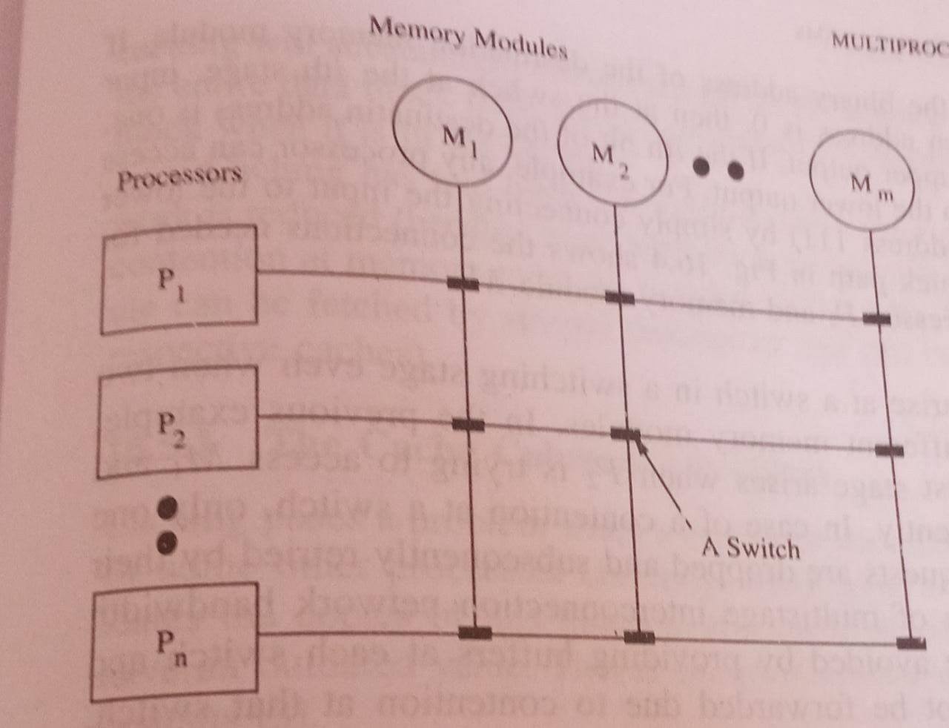
Cross–bar Switch

Slide 13
Multistage Interconnection Network
A compromise b/w bus and cross-bar switch
It permits simultaneous connection b/w several processor-memory pairs and is more cost effective when compared to cross-bar.
Consists of several stages of switches.
Each stage consist of equal no: of cross bar switches of same size.
O/p of switches in a stage is connected to the i/p’s of switches in the next stage.
There are numerous types of interconnection n/ws depending upon how i/p-o/p connections between adjacent stages are made.
A routing path b/w processor and memory module pair is given by a binary string that is derived from binary addresses of memory module and processor address

Slide 14
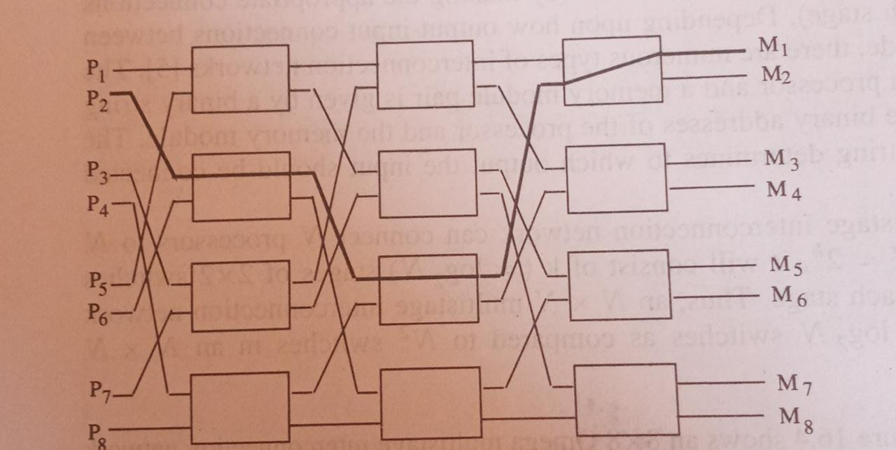
Multistage Interconnection Network

Slide 15
Multistage Interconnection Network
The i^{th} bit of this string determines to which output the input should be connected at the switch at stage i.
An NxN Multistage network can connect N processors to N memory modules.
If n=2^{k} ,it will consist of k(=log₂N) stages of 2x2 switches with N/2 Switches at each stage.
A contention can arise in a switch even when 2 processes are trying to access different memory modules.(P2->M1 and P6->M4)
In case of contention, only one request succeeds and rest are dropped and subsequently retried by their respective processors.
Rather than retry buffers can be used to buffer requests which can’t be forwarded due to contention

